Slide 1

HR Analytics Project (Employee Retention)
By Group 5
Mr. VIVEK GAJANAN CHAVAN
Mr. Balaji MS
Mr. Ratnakar Kolla
Ms. Mrugaya Mahendra Bane
Ms. Minu Kshirsagar
Ms. Yelisetty Sai Deepthi

Slide 2
Project Objective
In this HR Analytics project, we were provided with two datasets in excel format, each containing 50,000 rows.
The objective was to analyze the data and derive insights to assist the HR team in employee retention.
We utilized MS-Excel and MySQL for the analysis, performing calculations, merging datasets, and creating interactive dashboards.
Additionally, we prepared dashboards using Excel, Power BI, and Tableau tools.

Slide 3
KPI’S
1.Average Attrition rate for all Departments
2.Average Hourly rate of Male Research Scientist
3.Attrition rate Vs Monthly income stats
4.Average working years for each Department
5.Job Role Vs Work life balance
6.Attrition rate Vs Year since last promotion relation

Slide 4
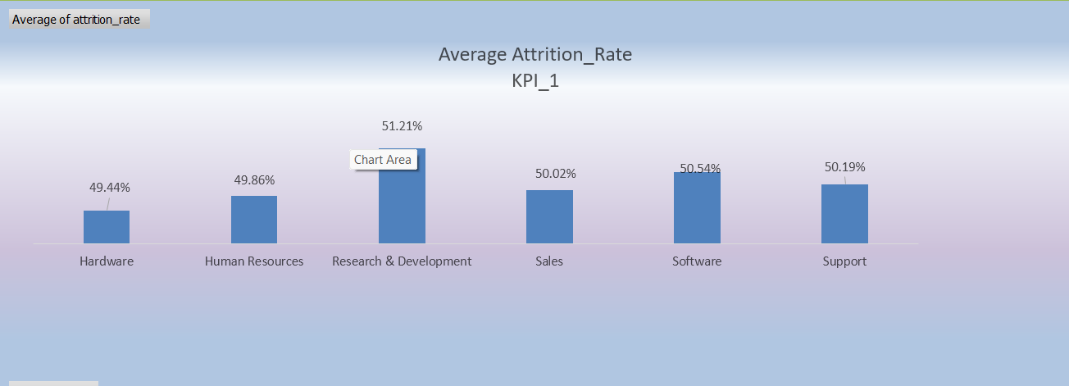
kpi-1
Average Attrition rate for all Departments:
* We had 50,000 employees data with us. Out of them 25,105 quit the job. So it comes around 50%.
* In this chart we can see that around 50% of employees from each department have left the job.
* The attrition rate is high in Research & Development department among all the departments followed by software department

Slide 5
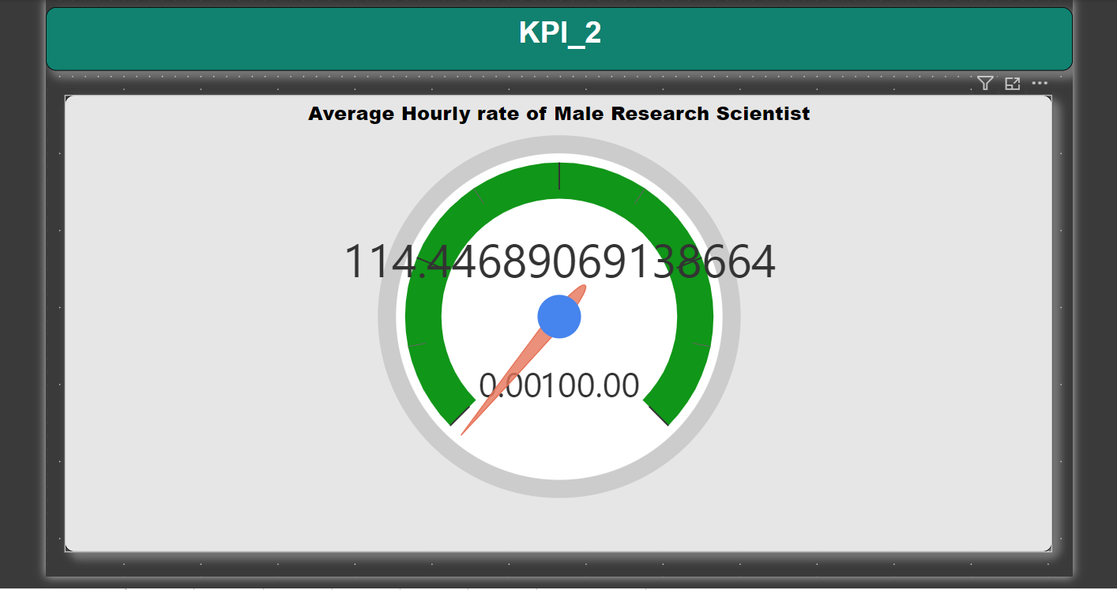
kpi-2
Average hourly rate of male research scientist:
* The average hourly rate of male research scientist is around 114.45.

Slide 6
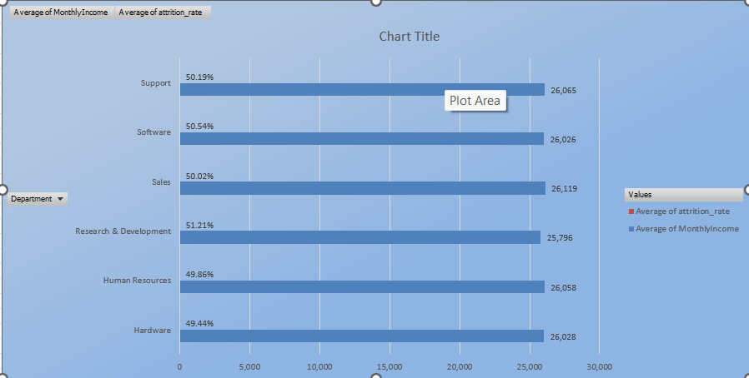
KPI-3
Attrition rate Vs Monthly income stats
In this chart we can see how monthly income is affecting attrition.
The data reveals a consistent attrition rate of around 50% across various monthly brackets.
Monthly income range from 50k-60k has seen highest attrition rate which is 51.26%
And lowest attrition is in range between 30k-40k which is 49.81%
As the salary increases there is more attrition.

Slide 7
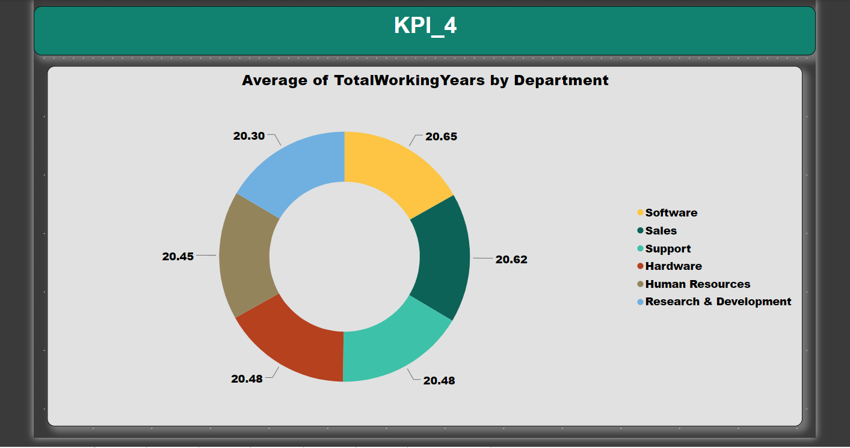
kpi-4
Average working years for each Department:
Here, we observe a consistency in working hours across departments, averaging approximately 20.45 hours.
The Software Department stands out with employees working longer hours compared to other departments."

Slide 8
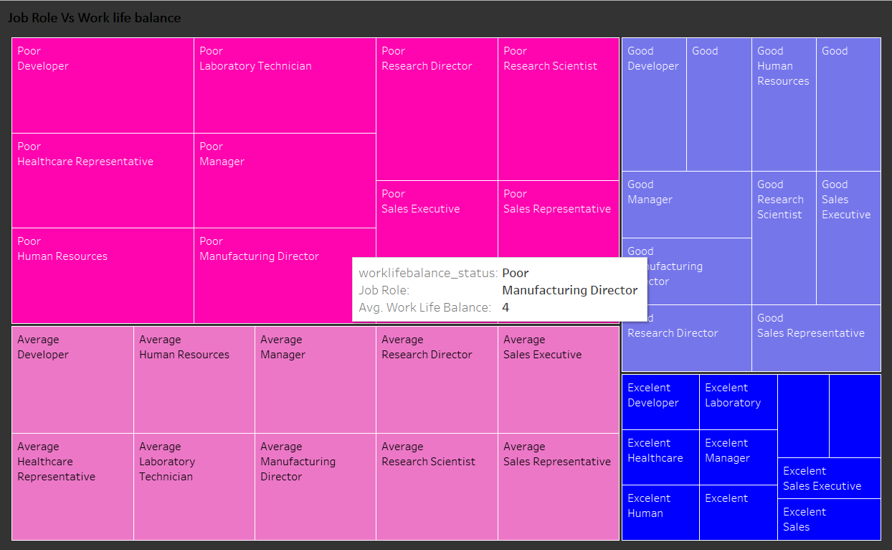
kpi-5
Job Role Vs Work life balance:
This table represents the ratings given by employees to the work life balance respective to their job role.
In comparing job roles and work-life balance, we can conclude the following:
For Manufacturing Directors, more employees seem to have a rating of 2, indicating that they can moderately manage both their job and work-life.
Sales Representatives show a more even distribution, suggesting that they are trying to balance both aspects according to their individual circumstances.
Each employee appears to have different strategies for managing both job and work-life.

Slide 9
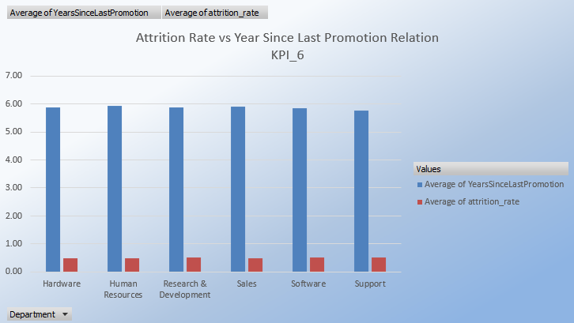
kpi-6
Attrition rate Vs Year since last promotion relation:
The data indicates a relatively stable attrition rate, hovering around 50%, across different ranges of years since the last promotion.
The attrition rate was higher in the 21-30 years since the last promotion group.

Slide 10
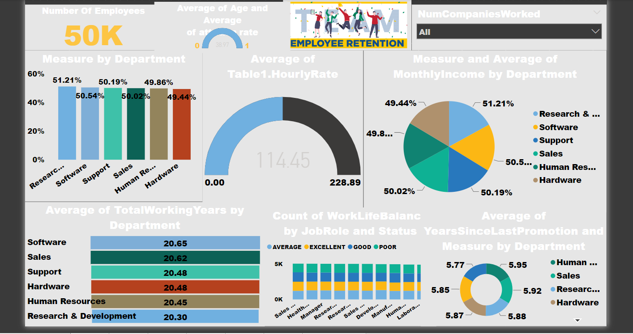
DASHBOARDS CLIP BY power BI - TOOL

Slide 11
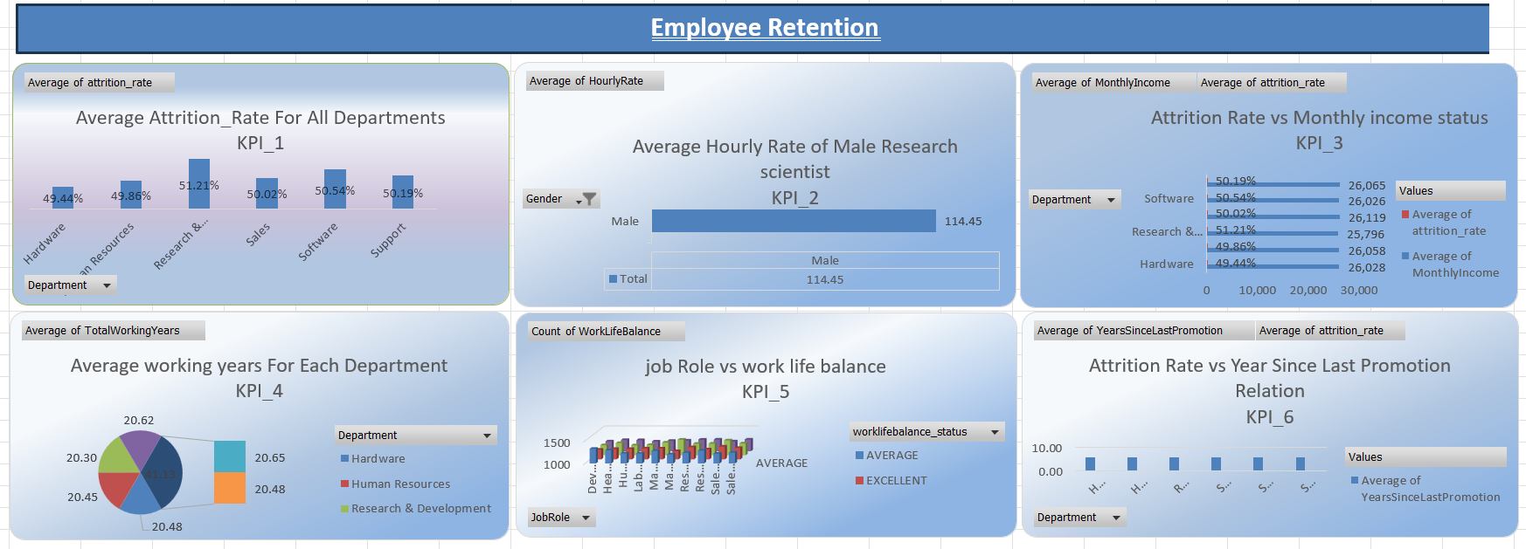
DASHBOARDS CLIP BY excel

Slide 12
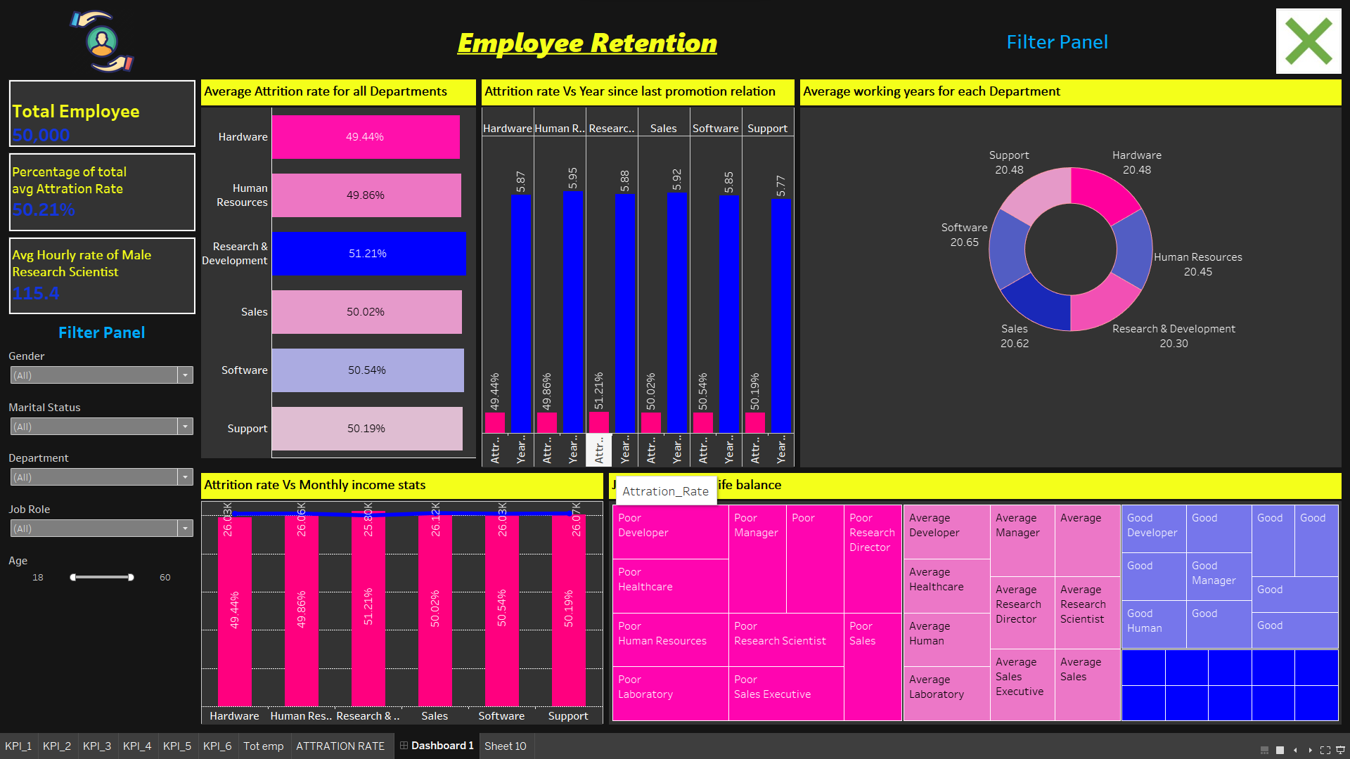
DASHBOARDS CLIP BY Tableau - TOOL

Slide 13


